Slide 1
Hypothesis
Unit IV

Slide 2
T-test
A t-test is a statistical test that compares the means of two samples.
It is used in hypothesis testing, with a null hypothesis that the difference in group means is zero and an alternate hypothesis that the difference in group means is different from zero.

Slide 3
T-test
How to perform T-tests in R
In the T-test, for specifying equal variances and a pooled variance estimate, we set var.equal=True. We can also use alternative="less" or alternative="greater" for specifying one-tailed test.
Different Types
one-sample,
paired sample, and
independent samples T-test

Slide 4
T-test
Take a sample from both sets and establish the problem assuming a null hypothesis that the two means are the same.
Classification of T-tests
One Sample T-test
Two sample T-test
Paired sample T-test

Slide 5

One-Sample T-test
One-Sample T-test is a T-test which compares the mean of a vector against a theoretical mean. There is a following formula which is used to compute the T-test :

Slide 6
One-Sample T-test
Here,
M is the mean.
? is the theoretical mean.
s is the standard deviation.
n is the number of observations.
For evaluating the statistical significance of the t-test, we need to compute the p-value. The p-value range starts from 0 to 1, and is interpreted as follow

Slide 7
One-Sample T-test
If the p-value is lower than 0.05, it means we are strongly confident to reject the null hypothesis.
If the p-value is higher than 0.05, then it indicates that we don't have enough evidence to reject the null hypothesis.
We construct the pvalue by looking at the corresponding absolute value of the t-test

Slide 8
One Sample T – Test Approach
The One-Sample T-Test is used to test the statistical difference between a sample mean and a known or assumed/hypothesized value of the mean in the population.
So, for performing a one-sample t-test in R, we would use the syntax t.test(y, mu = 0)
where x is the name of the variable of interest and
mu is set equal to the mean specified by the null hypothesis.

Slide 9
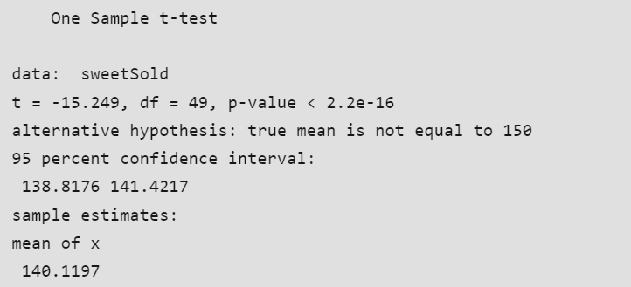
One Sample T – Test Approach

Slide 10
t = -15.249, df = 49, and a 2.2e-16 p-value: provides the p-value, degrees of freedom (df), and test statistic (t). The computed t-value in this instance is -15.249, there are 49 degrees of freedom, and the p-value is very small ( 2.2e-16), indicating strong evidence that the null hypothesis is false.
The true mean is not equal to 150, as an alternative explains the alternative theory, which contends that the population’s actual mean is not 150.
The confidence interval, which ranges from 138.8176 to 141.4217, shows that there is a 95% chance that the genuine population mean is located between those two numbers.
provides the sample estimate, in this example the sample mean (x) of 140.1197, or “sample estimates: mean of x 140.1197.”

Slide 11
Two sample T-Test Approach
It is used to help us to understand whether the difference between the two means is real or simply by chance.
The general form of the test is t.test(y1, y2, paired=FALSE). By default, R assumes that the variances of y1 and y2 are unequal, thus defaulting to Welch’s test. To toggle this, we use the flag var.equal=TRUE.

Slide 12
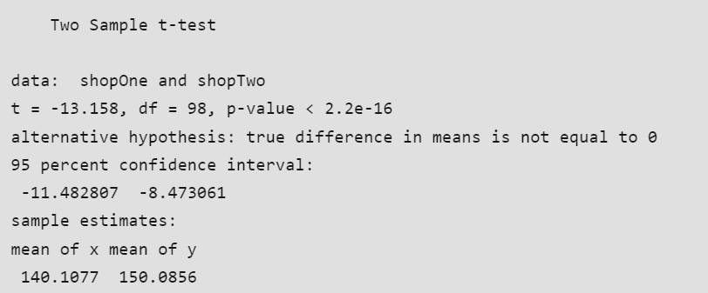
Two sample T-Test Approach
> shopOne <- rnorm(50, mean = 140, sd = 4.5)
> shopTwo <- rnorm(50, mean = 150, sd = 4)
> t.test(shopOne, shopTwo, var.equal = TRUE)

Slide 13
Two sample T-Test Approach
Sample estimates: 140.1077 for the mean of x and 150.0856 for the mean of y the sample means (x and y), which are the sample estimates. In this instance, shopOne’s mean is 140.1077, whereas shopTwo’s mean is 150.0856

Slide 14
Paired Sample T-test
This is a statistical procedure that is used to determine whether the mean difference between two sets of observations is zero.
In a paired sample t-test, each subject is measured two times, resulting in pairs of observations.
The test is run using the syntax t.test(y1, y2, paired=TRUE)

Slide 15
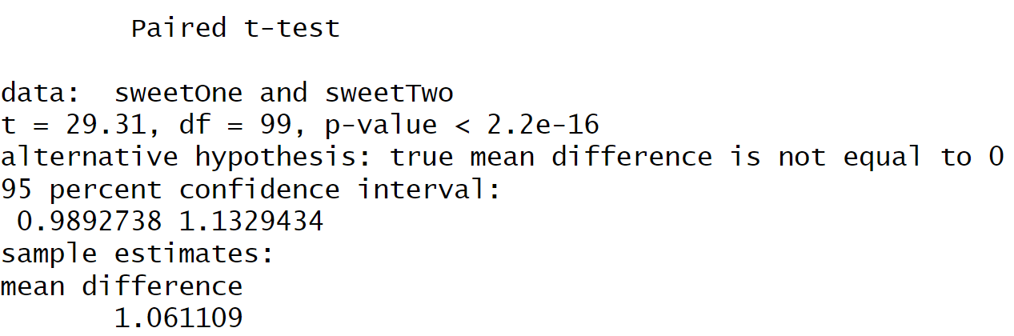
Paired Sample T-test
> set.seed(2820)
> sweetOne <- c(rnorm(100, mean = 14, sd = 0.3))
> sweetTwo <- c(rnorm(100, mean = 13, sd = 0.2))
> t.test(sweetOne, sweetTwo, paired = TRUE)

Slide 16
Correlation
Correlation is a statistical measure that indicates how strongly two variables are related.
It involves the relationship between multiple variables as well.
For instance, if one is interested to know whether there is a relationship between the heights of fathers and sons, a correlation coefficient can be calculated to answer this question.
Generally, it lies between -1 and +1.
It is a scaled version of covariance and provides the direction and strength of a relationship. Correlation coefficient test in R

Slide 17
Correlation
There are mainly two types of correlation:
Parametric Correlation – Pearson correlation(r): It measures a linear dependence between two variables (x and y) is known as a parametric correlation test because it depends on the distribution of the data.
Non-Parametric Correlation – Kendall(tau) and Spearman(rho): They are rank-based correlation coefficients, and are known as non-parametric correlation

Slide 18
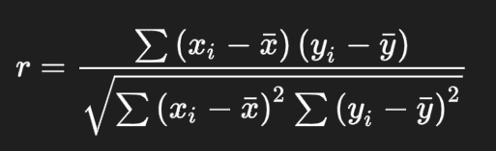
Pearson Rank Correlation Coefficient Formula
Pearson Rank Correlation is a parametric correlation.
The Pearson correlation coefficient is probably the most widely used measure for linear relationships between two normal distributed variables and thus often just called “correlation coefficient”.
The formula for calculating the Pearson Rank Correlation is as follows:

Slide 19
Pearson Rank Correlation Coefficient Formula
where,
r: pearson correlation coefficient
x and y: two vectors of length n
mx and my: corresponds to the means of x and y, respectively
Note:
r takes a value between -1 (negative correlation) and 1 (positive correlation).
r = 0 means no correlation.
Can not be applied to ordinal variables.
The sample size should be moderate (20-30) for good estimation.
Outliers can lead to misleading values means not robust with outliers

Slide 20
Pearson Rank Correlation Coefficient Formula
R Programming Language provides two methods to calculate the pearson correlation coefficient.
By using the functions cor() or cor.test() it can be calculated.
It can be noted that cor() computes the correlation coefficient whereas cor.test() computes the test for association or correlation between paired samples.
It returns both the correlation coefficient and the significance level(or p-value) of the correlation

Slide 21
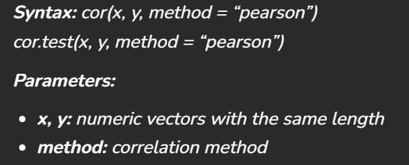
Pearson Rank Correlation Coefficient Formula

Slide 22
Pearson Rank Correlation Coefficient Formula
> x = c(1, 2, 3, 4, 5, 6, 7)
> y = c(1, 3, 6, 2, 7, 4, 5)
> result = cor(x, y, method = "pearson")
> cat("Pearson correlation coefficient is:", result)
Output
Pearson correlation coefficient is: 0.5357143

Slide 23
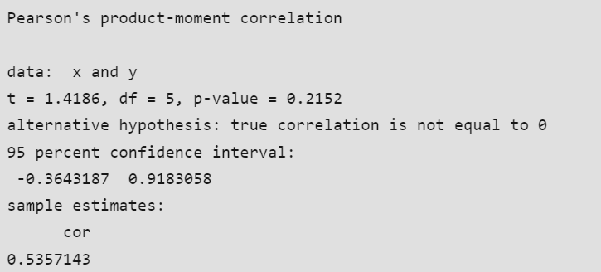
Correlation Coefficient Test In R Using cor.test() method
> x = c(1, 2, 3, 4, 5, 6, 7)
> y = c(1, 3, 6, 2, 7, 4, 5)
> result = cor.test(x, y, method = "pearson")
> print(result)

Slide 24
Correlation Coefficient Test In R Using cor.test() method
In the output above:
T is the value of the test statistic (T = 1.4186)
p-value is the significance level of the test statistic (p-value = 0.2152).
alternative hypothesis is a character string describing the alternative hypothesis (true correlation is not equal to 0).
sample estimates is the correlation coefficient. For Pearson correlation coefficient it’s named as cor (Cor.coeff = 0.5357)

Slide 25
Chi Square Test
A chi-square test is a statistical test used to compare observed results with expected results.
The purpose of this test is to determine if a difference between observed data
The chi-square formula is:
χ2 = ∑(Oi – Ei)2/Ei,
where Oi = observed value (actual value) and Ei = expected value.

Slide 26
Chi Square Test
The null hypothesis states that there is no relationship between the two variables,
while the research hypothesis states that there is a relationship between the two variables.
In a chi-square analysis, the p-value is the probability of obtaining a chi-square as large or larger than that in the current experiment and yet the data will still support the hypothesis.
It is the probability of deviations from what was expected being due to mere chance.

Slide 27
Chi Square Test
The chi-square test of independence evaluates whether there is an association between the categories of the two variables.
There are basically two types of random variables and they yield two types of data: numerical and categorical.
In R Programming Language Chi-square statistics is used to investigate whether distributions of categorical variables differ from one another.
The chi-square test is also useful while comparing the tallies or counts of categorical responses between two(or more) independent groups

Slide 28
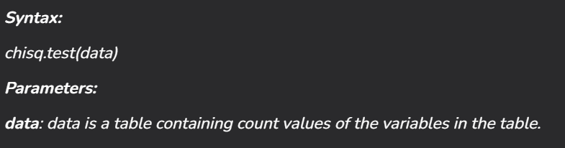
Chi Square Test
In R Programming Language, the function used for performing a chi-square test is chisq.test().
In R Programming Language, the function used for performing a chi-square test is chisq.test().
In R Programming Language, the function used for performing a chi-square test is
chisq.test().

Slide 29
Chi Square Test
In R Programming Language, the function used for performing a chi-square test is chisq.test().
In R Programming Language, the function used for performing a chi-square test is chisq.test().
In R Programming Language, the function used for performing a chi-square test is
chisq.test().

Slide 30
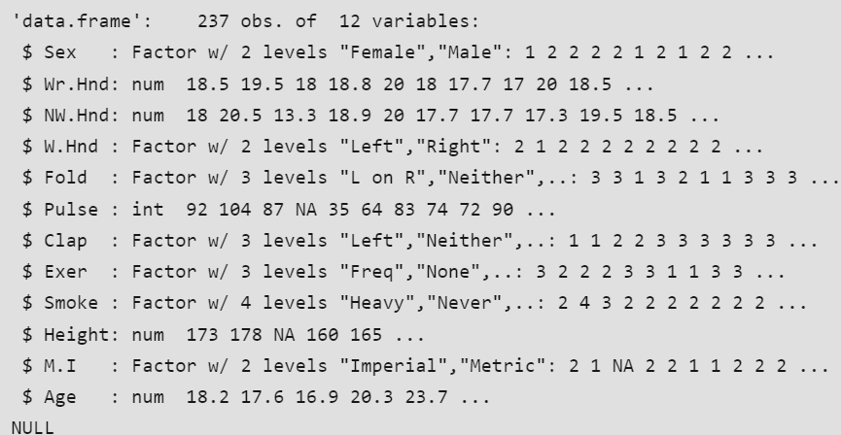
Chi Square Test
In R Programming Language, the function used for performing a chi-square test is chisq.test().
In R Programming Language, the function used for performing a chi-square test is chisq.test().
We will take the survey data in the MASS library which represents the data from a survey conducted on students.
We will take the survey data in the MASS library which represents the data from a survey conducted on students.
library(MASS)
print(str(survey))

Slide 31
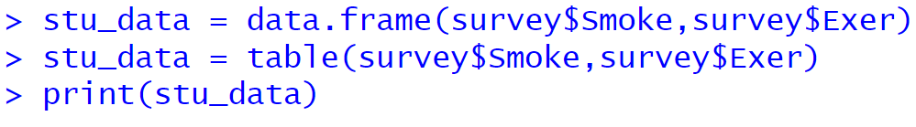
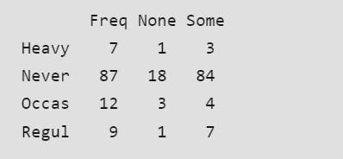
Chi Square Test
In R Programming Language, the function used for performing a chi-square test is chisq.test().
In R Programming Language, the function used for performing a chi-square test is chisq.test().
We will take the survey data in the MASS library which represents the data from a survey conducted on students.
For our model, we will consider the variables “Exer” and “Smoke“.
The Smoke column records the students smoking habits while the Exer column records their exercise level.
Our aim is to test the hypothesis whether the students smoking habit is independent of their exercise level at .05 significance level.

Slide 32
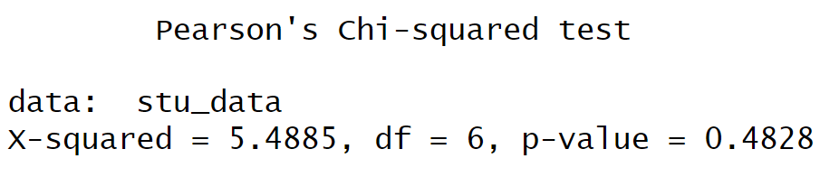
Chi Square Test
In R Programming Language, the function used for performing a chi-square test is chisq.test().
In R Programming Language, the function used for performing a chi-square test is chisq.test().
We will take the survey data in the MASS library which represents the data from a survey conducted on students.
And finally we apply the chisq.test() function to the contingency table stu_data.
chi_result <- chisq.test(stu_data)
print(chi_result)
As the p-value 0.4828 is greater than the .05, we conclude that the smoking habit is independent of the exercise level of the student and hence there is a weak or no correlation between the two variables.

